Slide 1


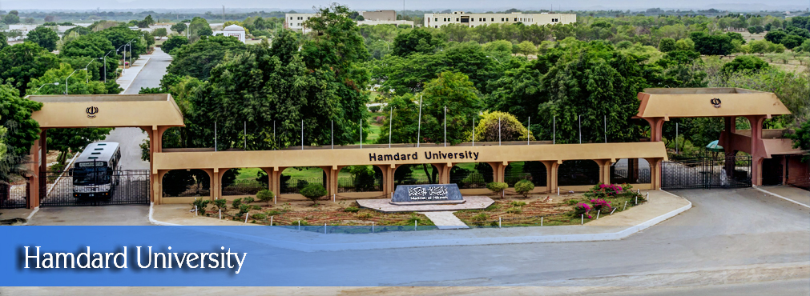
Dr.Crop Android app
FYP Proposal
Muhammad Ibrahim | (1895-2021)
Zeeshan Ali Wali Muhammad | (1505-2021) (1894-2021)
Supervisor Mr. Saifullah Adnan
Hamdard University

Slide 2
Outline
Group Introduction
Problem Statement
Project Objectives
Project Scope
Architectural Big Picture
Methodology
Role & Responsibility
Project Milestones
Project Plan (Time lines)
Project Budgeting
Project Tools
Project Deliverables

Slide 3
Group Introduction
Group Members
Muhammad Ibrahim
Wali Muhammad
Zeeshan Ali
Supervisor: Mr Saifullah Adnan
Why we selected him as supervisor?
We have selected him as our supervisor because he guided us regarding our project and gave us some valuable information regarding FYP..
Relevant Expertise
He has experience in similar domain and industry project which is related to our project.
Relevant Experience
He has 3+ years of prolific experience in academia and IT industry.

Slide 4
Problem Statement
The primary problem this project addresses is the lack of accessible, accurate, and rapid disease detection tools for cotton and wheat plants.
Cotton: (Mealy bug)
Mealy bugs feed on the plant sap, weakening the cotton plants and leading to reduced growth and vigor. This results in lower cotton yields, impacting the farmer's productivity and income.
Wheat: (Rust)
Rust diseases can significantly reduce wheat yield by damaging the plant's photosynthetic capacity and overall health.
Rust infections can lead to poor grain quality, affecting the marketability and nutritional value of the wheat.

Slide 5
Project Objectives
Develop an advanced image recognition system that can accurately detect mealy bug infestations in cotton plants and rust diseases in wheat plants at an early stage.
Minimize crop damage by enabling timely intervention.
Create an intuitive and accessible interface tailored to the needs of cotton and wheat farmers, making it easy to upload images and receive diagnostic results.
Ensure high adoption rates and usability among farmers.
Integrate educational resources within the app to inform farmers about the symptoms, prevention methods, and best practices for managing mealy bug infestations and rust diseases.

Slide 6
Project Scope
Utilizing machine learning models to identify plant diseases from photos taken with a smartphone camera . Providing instant feedback on the health status of the plant. A comprehensive library of plant diseases with descriptions, symptoms, and imagesn.Recommending treatments or preventive measures for detected diseases.

Slide 7
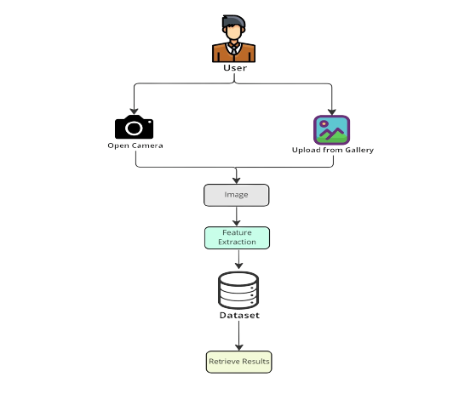
Architecture Big Picture

Slide 8
Project Methodology
Design Methodologies:
Human-Centered Design (HCD): Focuses on understanding user needs and behaviors to design an intuitive and user-friendly interface.
User Experience (UX) Design: Prioritizes creating a seamless and secure user experience for image storage and sharing.
Agile Design: Iterative and incremental approach to design, allowing for flexibility and adaptability throughout the development process.
Development Methodologies:
Agile Development: Iterative and incremental approach to development, emphasizing collaboration, flexibility, and rapid delivery.
Scrum Framework: Structured approach to Agile development, utilizing sprints, daily stand-ups, and continuous improvement.
Secure Development Life Cycle: Integrating security practices and testing throughout the development process to ensure a secure final product.
Evalutionary Prototype: It will ensure that the system will develop the core functionality of
real time image capture and encryption.

Slide 9
Project Role & Responsibilities
RACI Chart
Tasks | M Ibrahim | Zeeshan Ali | Wali Muhammad | Mr.Saifullah Adnan
Project Planning | R | A | A | I
Frontend development | A | A | R | C
Backend development | A | R | A | I
Decision tree | R | A | A | C
Logistic regression | R | A | A | I
Random forest | A | R | A | I
Testing | A | A | R | C
Deployment | A | R | A | I

Slide 10
Project Milestones
Requirement Gathering
Feasibility Study
Design Phase
Backend Development
Frontend Development
Decision Tree
Random Tree
Model Training and Testing
Deployment
Post Deployment Support and Updates

Slide 11
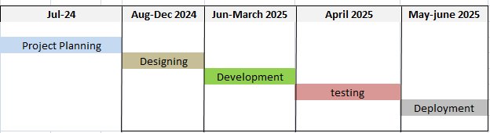
Project Plan

Slide 12
Project Budgeting
Estimated budget of project major resources
Developers (2 @ 500 x 4days x 4 week = 8000 x 12 = PKR 96,000 est.)
Hard Drive (Rs. 14,000 x 2 = PKR 28,000 est.)
Laptop (Rs. 50,000 x 2 = PKR 100,000 est.)
Electricity (Rs. 5000 x 12 = PKR 60,000 est.)
Internet (3000 x 12 = PKR 36,000 est.).
Domain PKR 5000/yr est.
Hosting PKR 4000/month est x 12 = PKR 48,000 est.
Miscellaneous Costs 5000pkr
Total cost PKR 378,000‬ est.

Slide 13
Project Tools
Software Requirements
Hardware Requirements
Visual Code
Andriod studio
Colab
Laptop (Multi-Core, i5, 8GB, 256GB SSD)
Backup Hard drives

Slide 14
8- Project Deliverables
FYP-I Evaluation
FYP-II Evaluation
Prorotype of the application.
Fully functional deployment of Application with complete documentation.

Slide 15
THANK YOU!

